Slide 1
What is the mechanism of protein folding and mis-folding
Phenomena | Folding | Mis-folding
Ribosome assembles protein | Co translational Plasma ER(edoplamatic reticulum)
Chaperones Increase efficiency of folding, and not its rate | -Guide folding And prevent misfolding -ATP required for optimal function of these chaperones -upregulated during stress | Faulty chaperones will contribute/fail to prevent- aggregation
Folding catalysts |  | Their failure will allow longer times for misfolded states to be available.
ER- quality control | -glycosylation /deglycosylation -degredation of misfolded species -upregulated during stress | -failure in ER quality control may lead to mis-folding -Failure in degradation of misfolded protein can cause protein oligomer fragments that promote agregation

Slide 2
Driving forces of folding and mis-folding
Phenomena | Folding | Mis-folding
Energy landscape | Usually in thermodynamic equilibrium in physiological conditions
Statistical thermodynamics | Samples all energetic state until it finds the minimal folded state. | Amyloid fiber aggregates gain stability from hydrogen bond network, this allows them to be stable for long enough to grow larger
Secondary structure assembly dominated by Main chain hydrogen bonding(carbonyl to amide groups) | Very fast Alpha helix-nanosec Beta sheets- microsecs | Network of hydrogen bonds, that build an amyloid fiber
Residues | Small number of residues compose the –”folding nucleus” from which the rest of the structure quickly condenses. | -Amyloids- alternating hydrophobic and polar residues that favor beta sheets -nucleates in different sites then “folding nucleus” of native protien
Trasition state population | At least one exists when above 100 residues
Final step | Cooperative folding that leads to epulsion of water mollecules

Slide 3
Contact order- average distance between two side chains. As related to sequence, divided by total protein length.

Slide 4
The key molecular events and formed species
Ribosome assembles protein monomer
Chaperones and folding catalysts bind and regulate folding
Protein may complete folding co translationally, in the cytoplasm, or in the ER
The ER regulates folding by glycosylation/deglycolysation
Degradation of failed protein folding attempts(misfolded) to amino acids/ protein oligomers that inhibit aggregation?

Slide 5
The key molecular events and formed species
Misfolding
-any dysfunction in protein folding regulation(either in ER, or chaprones etc), may cause misfolding to commence/ presist
Improper degradation of protein oligomers, may also cause aggregation, as aggregation promoting oligamer species are present instead of aggregation inhibitory species.?
For amyloids
a lag stage similar to nucleation where a beta sheet crystal has not reached a critical nucleus size
Once critical nucleus of beta sheets reached, Chain growth begins
Beta sheets connected by hydrogen bond networks, comprise proto-filament
thi

Slide 6
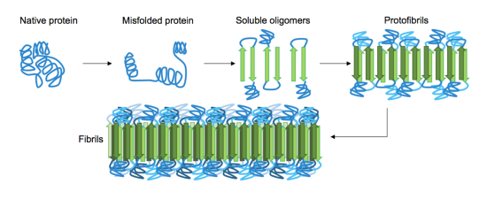

Structural characteristics of the endpoint fibril
Beta sheets hydrogen network
$$=$$
Beta -Sheet

